Slide 1
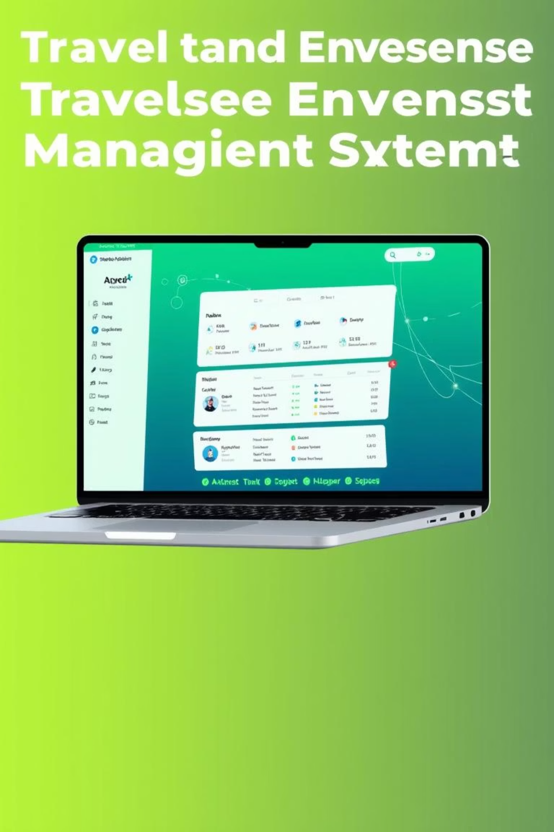
Travel & Expense Management System: Project Overview
This presentation outlines the detailed requirements for developing a comprehensive Travel and Expense Management System. We will explore each feature, focusing on the technical implementation using HTML, CSS, JavaScript, and MongoDB, and highlight the user experience aspects.

Slide 2



Core User Management & Profile
Login & Signup
User Profile View
Logout & Session Reset
Secure user authentication with robust input validation. Implement JWT for session management.
Display user details with options for password changes and general account settings. Ensure data privacy.
Clear session data and tokens upon logout to enhance security. Implement idle session timeout.

Slide 3

Trip Management Functionality
Create & Manage Trips
Users can create new trips, specifying name, dates, and an overall budget. Implement dynamic date pickers and budget validation.
Comprehensive options for editing and deleting existing trips. Ensure cascade deletion of associated expenses for data integrity.

Slide 4
Expense Tracking & Categorisation
Add Expenses to Trips
1
Capture expense details: title, amount, date, and category. Use a pre-defined list of categories with 'Other' option.
Edit & Delete Expenses
2
Provide granular control over individual expense entries. Implement confirmation dialogues for deletions.
Filter Expenses by Category
3
Enable dynamic filtering of expenses within a trip based on user-selected categories.

Slide 5


Reporting & Data Visualisation
Gain insights into spending habits with powerful reporting tools.
85%
60%
View Trip Summary
Expense Categorisation Chart
Display total expenses versus the allocated budget for each trip, including an expense percentage.
Visualise expense distribution with an interactive pie chart, utilising Chart.js or canvas.

Slide 6

Search, Sort & Filtering Capabilities
Dynamic Trip Sorting
Sort trip lists by date (ascending/descending) or alphabetically by trip name.
Live Search for Trips
Implement a real-time search functionality for trips based on keywords from names or descriptions.

Slide 7

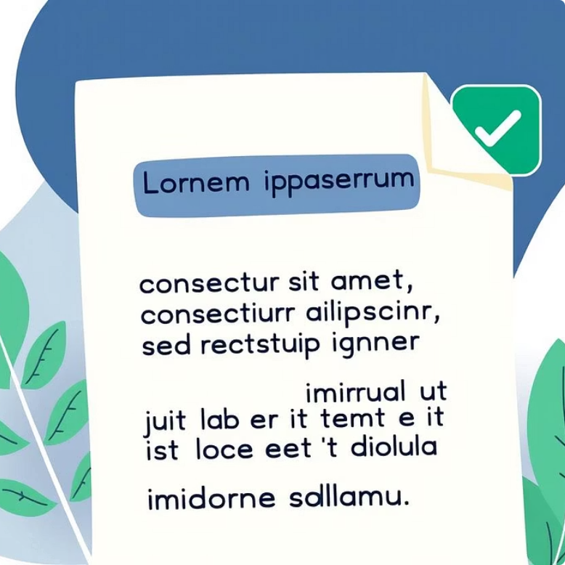

Export & Print Functionality
Download Profile Summary
Download Trip Report
Print Option
Enable downloading of detailed individual trip reports in PDF format for easy sharing and record-keeping.
Provide a dedicated print option for both profile summaries and individual trip reports, optimising for physical output.
Generate and allow download of a user's entire expense summary as a PDF document.

Slide 8
User Experience & Technical Enhancements
1
2
3
Responsive Design
Theme Toggle
Validation & Alerts
Ensure optimal viewing and interaction across all devices (desktop, tablet, mobile) using CSS media queries.
Allow users to switch between dark and light themes for personalised visual comfort.
Implement client-side validation for all input fields and provide clear, informative alerts for errors or success messages.

